Slide 1
Classification of Air Quality Index
Group 20
Shakti Singh Rathore
Bablu Prajapati

Slide 2
Problem Statement
To classify Air Quality Index in Good, Moderate and Poor based on the features from data collected from Government of INDIA.

Slide 3
Introduction
Air Quality Index is the measurement of different harmful gases involve in the environment.
After Predicating the value of AQI we can determine the level of pollution.
AQI value can tell us to Quality of Air in environment whether it is good, moderate or poor.

Slide 4
Dataset
The data is combined (across the years and states) and largely clean version of the Historical Daily Ambient Air Quality Data released by the Ministry of Environment and Forests and Central Pollution Control Board of India under the National Data Sharing and Accessibility Policy (NDSAP) year 1990-2015

Slide 5
Approach
As from the above data we can see that there is lot of missing values so first we applied various ensemble technique then we convert the concentration of different gases into AQI category and apply hot encoding to convert categorical data into binary so we can feed it our model then we tried various technique like SMOTE and after that come out with different classification models

Slide 6
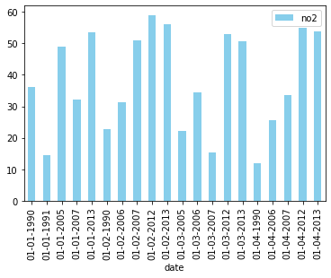
Visualization: we can see clearly that emission of harmful gases increase year by year.

Slide 7
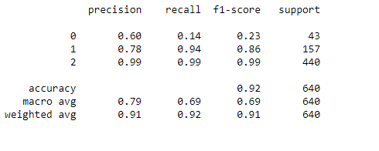
Logistic Regression
The accuracy of this model is 91%
The precision and recall is 86% and 81%

Slide 8
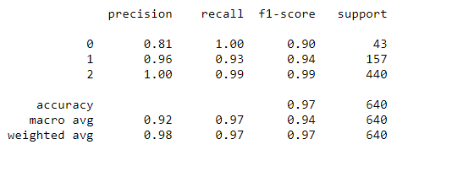
Logistic Regression with SMOTE
The accuracy of this model is 97.8%
The precision and recall is 97% and 99%

Slide 9
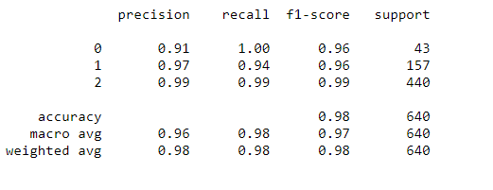
K-Nearest Neighbors
The accuracy of this model is 97.9% .
The precision and recall is 95% and 97%

Slide 10
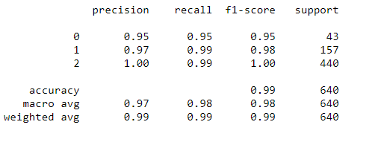
Support Vector Classification
The accuracy of this model is 98%
The precision and recall is 94% and 98%

Slide 11
Conclusion
Model | Accuracy (%) | Precision | Recall
Logistic Regression with SMOTE | 0.978 | .97 | .99
KNN Classifier | 0.979 | .95 | .97
Support Vector Classifier | .98 | .94 | .98
Logistic Regression | 0.92 | .86 | .81
As per the above comparison, the best fit model is Logistic Regression with SMOTE with 97.8 % accuracy and recall and precision is 99% and 97% it can help us to identify the category of pollution

Slide 12
Thank You!

